Slide 1
Python

Slide 2
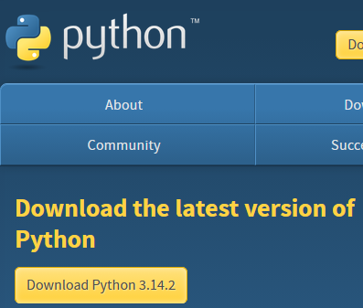

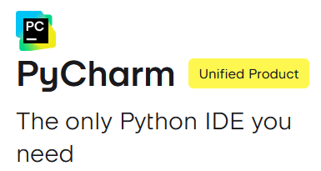
Required Software
Python
PyCharm OR VSCode

Slide 3
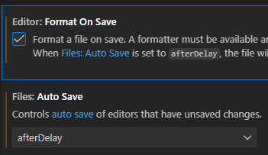
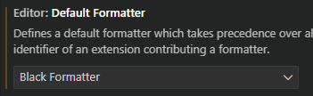
VSCode Settings/Plugins
Python + Pylance - language support
Jupyter - visualization
Black Formatter - follow consistent standard
Isort - organize imports
flake8/pylint/ruff - linting
Python test explorer - unit test support
Live Share - collaborative editing

Slide 4
What is Python?
Interpreted language - code is executed line by line, no compilation step needed
High-level language - abstracts away low-level memory management, hardware details, garbage collection
Dynamically typed - variables do not require type declarations
Cross-platform - runs on windows, macOS, linux
Object-oriented - supports classes, objects, inheritance, etc.

Slide 5
Under the Hood
Python code (.py files) are compiled into bytecode (NOT machine code) by CPython
The bytecode is then interpreted and executed by the Python Virtual Machine (PVM) inside CPython

Slide 6
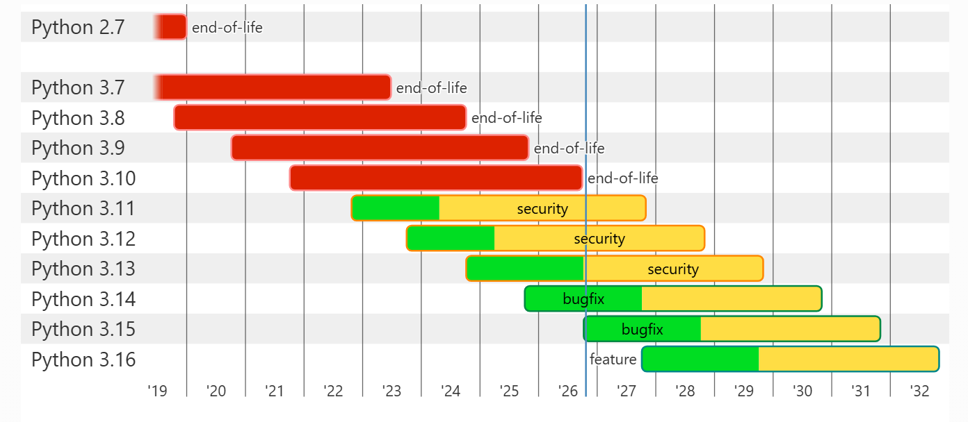
Installing Python
Python.org – has a handy chart to determine which python version you’d likely want your app to support
Regardless of your desired version, on Windows, just install via the ‘Python Install Manager’
  We can set the desired runtime of our projects separately

Slide 7
(Windows) Py vs python vs pymanager commands
Python – everyday use
  Runs the default interpreter unless a virtual environment or script configuration selects another one
  Python --version, python app.py
Py – version selection and management
  Use it to select a particular interpreter, list installations, and install or uninstall runtimes
  Py list, py -3.12 app.py
Pymanager – unambiguous management command
  This invokes the new manager even if the py command conflicts with an older launcher
  Pymanager list, pymanager install 3.14

Slide 8
Python Environments
Default Python Interpreter: When Python is installed, it comes with a default interpreter on the system that can execute Python code. This is typically accessed using commands like python or python3.
System-Wide Packages: Packages installed into the default Python environment may be available to multiple projects that use that interpreter.
The Problem with Shared Environments: Different projects may require different versions of the same package, which can cause dependency conflicts if everything is installed into one environment.
Virtual Environments (venv): Python provides a built-in venv module that allows us to create isolated environments for individual projects.
Separate Dependencies: Each virtual environment can have its own installed packages and versions, so changes in one project do not affect another project's dependencies.
Same Python, Isolated Environment: A virtual environment is typically created using an existing Python interpreter, but it maintains its own package installation directory and environment configuration.
Easy to Reproduce Projects: By recording dependencies in a requirements.txt file or a lock file, we can recreate a project's environment on another machine.

Slide 9

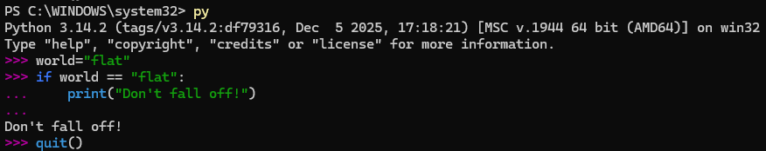
Python Environments, py, & Interactive Mode
Py commands work best in powershell, this is a Windows exclusive tool

Slide 10
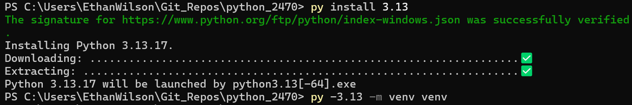
venv
Create a virtual environment for our python app (with the default version):
Create a virtual environment for our python app (with a selected version):
Make sure to activate, and then check for pip updates:
Some may need to allow scripts to run these commands:

Slide 11
pip & Jupyter setup
We install packages with pip (‘pip installs packages):
Packages may also be installed via text file on each new line:
Here we connect our venv to serve as the kernel for jupyter:

Slide 12
Challenge
Goal:
Create a Jupyter notebook for learning
Details: ~10 min
Create a project folder
Initialize a venv inside the project folder
Install the following packages to the venv: jupyter, ipykernel, numpy, pandas, matplotlib
Associate the venv with jupyter and launch your notebook

Slide 13

Strings, Print, Input, & Comments
Strings are valid with both single and double quotes
We can start a new line with the escape character ‘\’ + ‘n’

Slide 14


Variables & len()
Variables are dynamically typed:
Python is case-sensitive:

Slide 15
More on variables & Case Conventions
Must start with a letter or underscore character
Only alphanumeric symbols and underscores are valid: (A-z, 0-9, and _ )
Camel Case (rarely used convention in Python):
myVariable = ‘John’
Pascal Case (used for Python class names):
MyVariable = ‘John’
Snake Case (most common in Python; used for almost everything not a class):
my_variable_name = ‘John’
Kebab Case (never or rarely used in python)
My-variable-name = ‘John’

Slide 16
Variables Continued
We can assign multiple variables at once
We can also assign them the same value

Slide 17

Challenge
Goal:
Ask a user for their info and print it
Tip: Use the title() method to format names:
Details: ~10 min
Ask the user for their full name, birthday, & email
Store the data in variables
Print the information back to the console, on a new line for each item

Slide 18
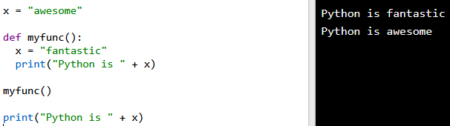
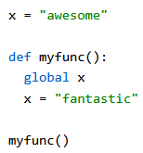
Functions & Variable Scope
Functions are defined with the ‘def’ keyword
Variables outside of functions have Global scope
Variables inside functions have Local scope, unless the global keyword is used

Slide 19
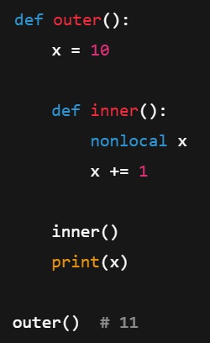
Built-In Scope & Enclosing (nonlocal) Scope
Built-In Scope
OOB methods/keywords provided by Python:
len()
print()
str()
Enclosing Scope
Inner functions have access
Can’t override unless we use nonlocal keyword

Slide 20
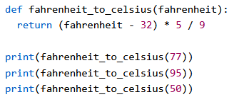
Functions take in and return data

Slide 21

Creating Placeholder Functions
Functions can’t be empty, but we can create placeholder functions using the ‘pass’ keyword!

Slide 22
Challenge
Goal:
Refactor previous challenge
Details: ~10 min
In a function:
Ask the user for their full name, birthday, & email
Store the data in variables
Print the information back to the console, on a new line for each item

Slide 23
More on naming conventions…
Item | Convention | Example
Variable | snake_case | user_name
Function | snake_case | get_user()
Constant | UPPER_SNAKE_CASE | MAX_SIZE
Class | PascalCase | UserService
Method | snake_case | save()
Attribute | snake_case | created_at
Protected | _snake_case | _cache
Private | __snake_case | __state
Module | snake_case.py | email_utils.py
Package | snake_case/ | data_access/

Slide 24
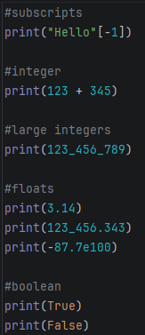

Data Types
str = string
int = integer
float = decimals
bool = boolean true/false
None = NoneType
(These are examples of Primitive data types, there are many more)

Slide 25
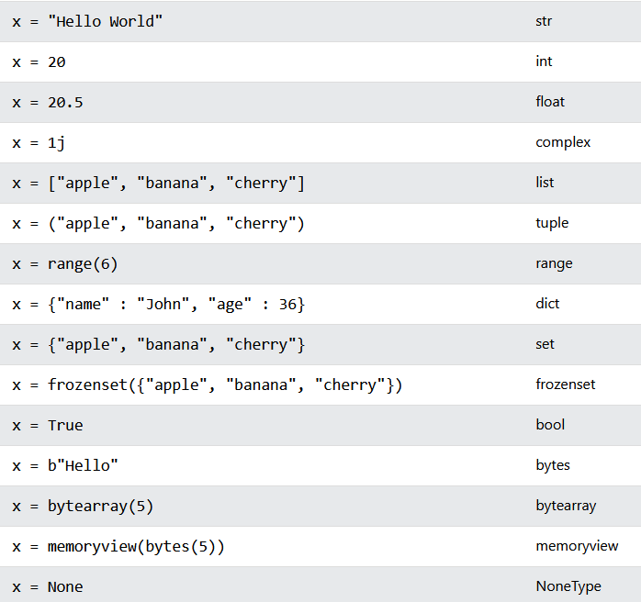
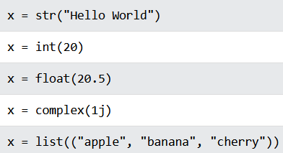
Setting Each Type
You can also use constructor functions to define the type explicitly:

Slide 26
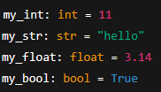


Type Hinting
Type hinting does NOT enforce the type at runtime
It’s for: linters (mypy, pyright), IDEs, readability

Slide 27
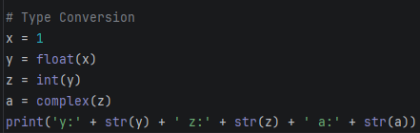
Type Conversion - Casting
If you convert a float to an int, data loss can occur
You cannot convert complex numbers into another datatype

Slide 28
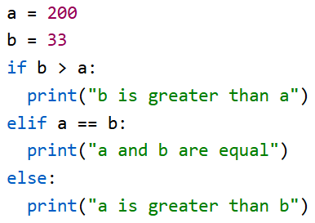
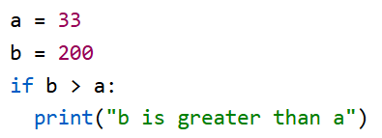
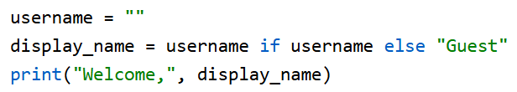
Control Flow

Slide 29
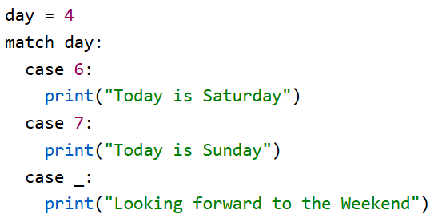
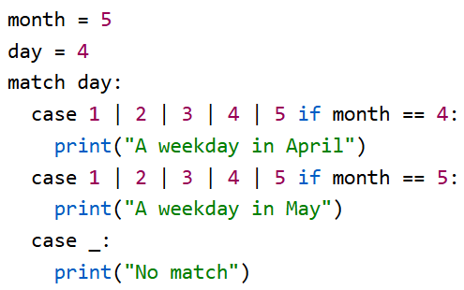
Match
‘_’ will always match, so place it at the end!
We can match multiple conditions at once
We can optionally include an if condition as an extra condition check

Slide 30
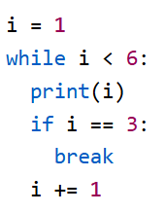
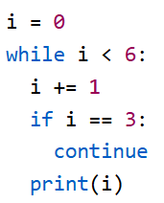
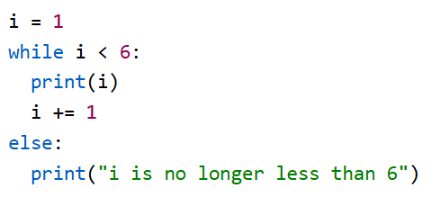
While Loops
What is the output of the following:

Slide 31
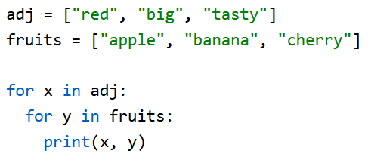


For Loops
We can use for loops to iterate over lists, tuples, dictionaries, sets, or strings
For loops may be nested
Break/Continue is available
We can use range() to iterate a certain number of times, or by a sequence

Slide 32
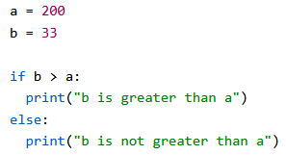

Boolean Behavior & If Statements
Logical evaluations will return a boolean
If statements use evaluations to route logic
The bool() constructor will make an evaluation of whatever is passed to it (The example returns ‘true’ for both)

Slide 33
Boolean Falsy Values
print(bool(False)) # bool
print(bool(None)) # NoneType
print(bool(0)) # int
print(bool("")) # str
print(bool(())) # tuple
print(bool([])) # list
print(bool({})) # dict

Slide 34
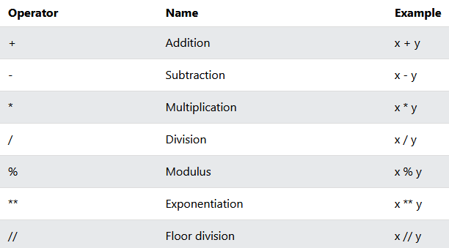
Arithmetic Operators
/ = returns float
// = returns integer

Slide 35
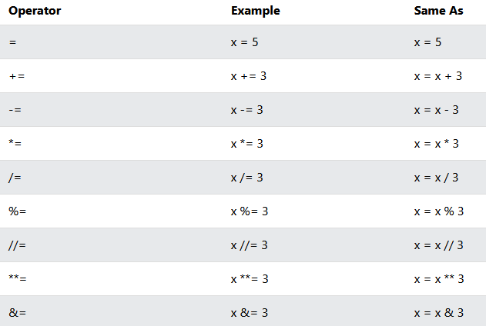
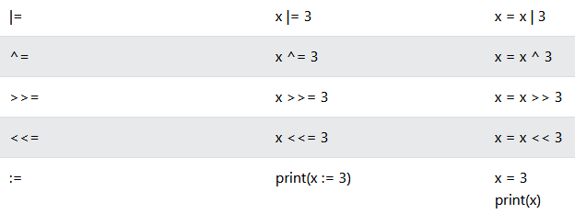
Assignment Operators
“:=” = python 3 walrus operator. It can accept an evaluation!

Slide 36
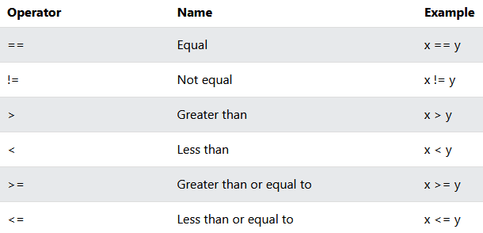
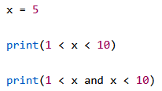
Comparison Operator
We may chain them!

Slide 37
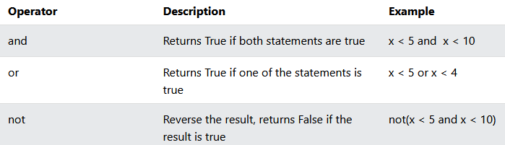
Logical Operators

Slide 38
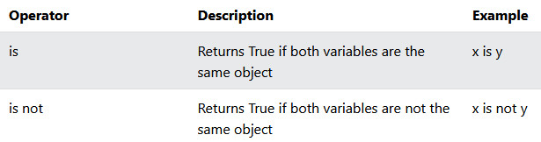
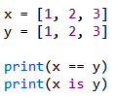

Identity Operators

Slide 39
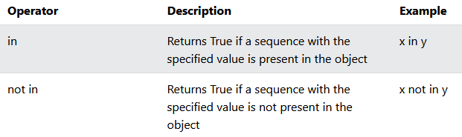

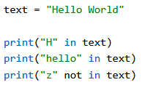

Membership Operators

Slide 40
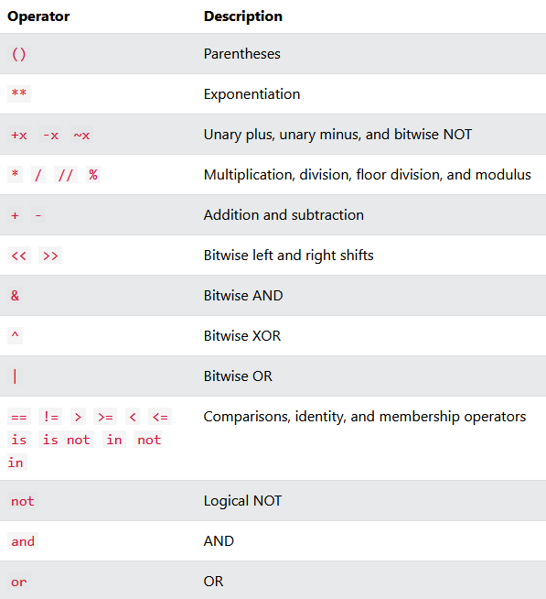
Operator Precedence
Remember PEMDAS?

Slide 41
Challenge
Goal:
PyCharm challenges
Details: ~45-60 min
Complete the following in the 100 Days of Code PyCharm course:
Day 1 (All tasks)
Day 2 (All tasks)
Day 3 (All tasks)

Slide 42

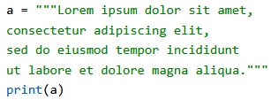
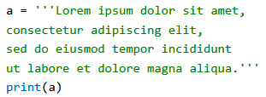
Quoteception, escape characters, & Multi-Line Strings

Slide 43


Check the contents of a string

Slide 44



Slicing Strings
Slice from the start: ‘Hello’
Or from the end: ‘llo, World!’
‘llo’
2 inclusive
5 exclusive

Slide 45





Other String Methods
Force upper/lower case text
Remove whitespace at the beginning/end of strings
Replace every piece of matching text content with another string
Return a list of split strings

Slide 46




F-Strings
Formatted String literals were introduced in Python 3
Dynamically assign values in strings
Perform evaluations & format data

Slide 47

R-Strings
Raw strings will force the string to behave literally:

Slide 48
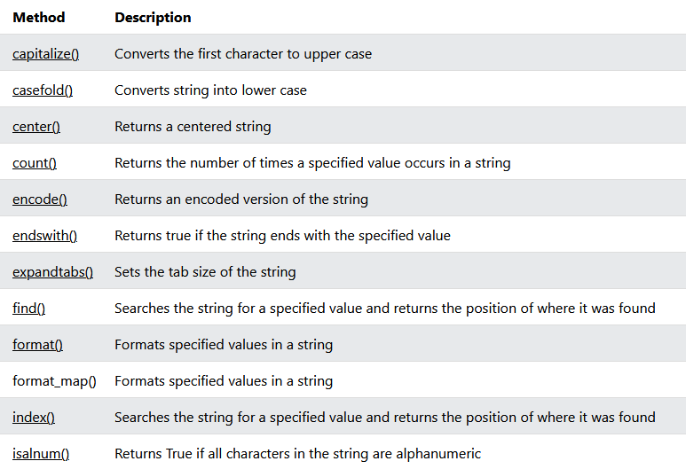
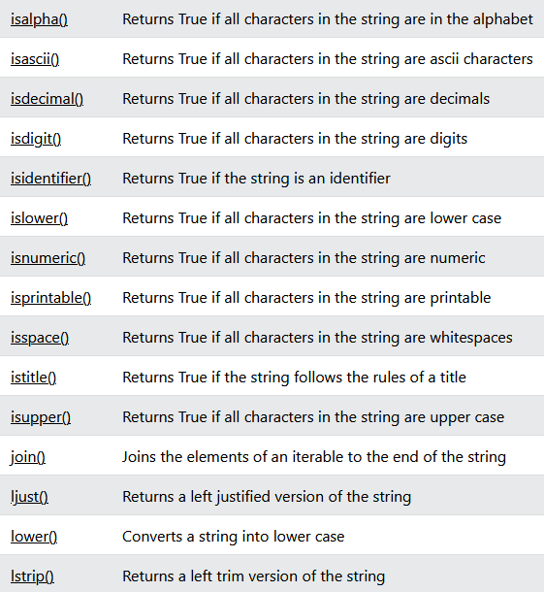
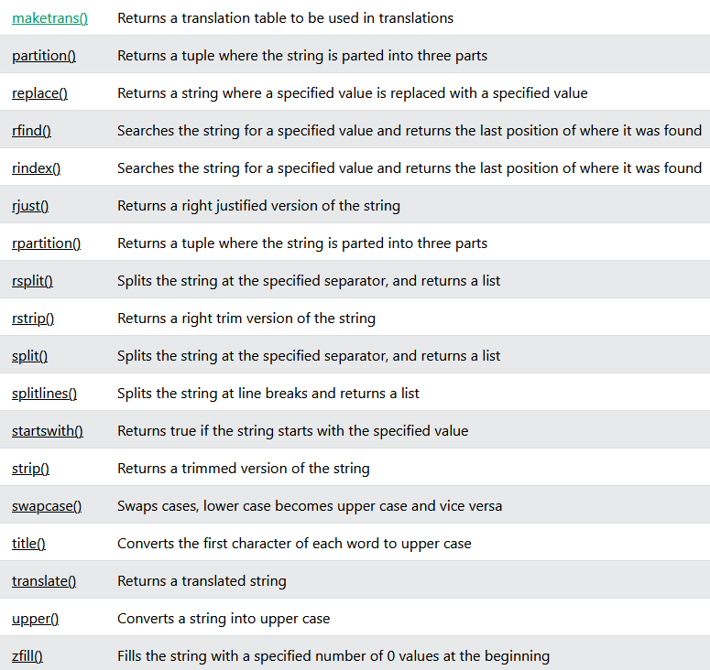
String Method Reference
https://www.w3schools.com/python/python_strings_methods.asp

Slide 49
Challenge
Goal:
Format a string value
Details: ~25 min
Given the username:
‘raw_username = " Py_Thon-ROCKS123!!! "
Do the following:
Remove whitespace
Convert to all lowercase
Replace all ‘-’ with ‘_’
Remove all ‘!’
Check at least once digit is present
Check it contains the word ‘python’
Create a variable that stores only the first 8 characters
Print a formatted string (f-string) that displays: the cleaned username, whether it contains a digit, whether it contains ‘python’, & the first 8 characters

Slide 50
Collections
Lists
  Ordered/indexed
  Changeable
  Allows duplicates
Tuples
  Ordered
  Unchangeable
  Allows duplicates
Sets
  Unordered
  Unchangeable
  Unindexed
Dictionaries
  Ordered
  Changeable
  No duplicates

Slide 51
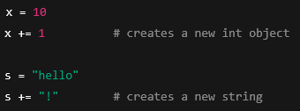
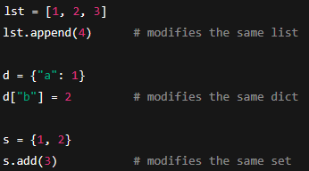
Immutable vs Mutable Types
Non-collection types are also called immutable, because a new space is reserved in memory for each new declaration.
Collections are mutable because we may add and remove to the existing object in memory.

Slide 52




Lists
We can easily get the length of a list
Lists can be ANY datatype
Lists can contain mixed datatypes
Retrieve items from positive/negative indices

Slide 53

More List Syntax
Get a range of items
Get a range of items from the beginning to a defined stop point
Get a range of items from a defined start point till the end
Check if items are in a list

Slide 54






Modifying Lists
Replace items in a list from its index
Insert multiple new items into a list while replacing items
Insert items without replacing anything
Add items to the end of a list
Concatenate a list and another list/set/dictionary

Slide 55




Modifying Lists
Remove a specific object by its identity
Remove a specific item by its index with pop(), or just the last item if nothing specified
The del keyword can delete an item or the list itself
The clear() method empties the list but the list still exists in memory

Slide 56


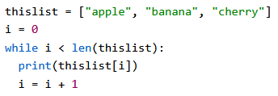

Iterating over lists
For loops can iterate over lists
While loops can iterate over lists
List Comprehension syntax is the shortest form to iterate over a list

Slide 57
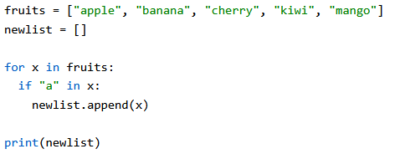
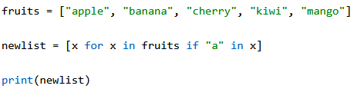
List Comprehension
Create a new list of fruits that have ‘a’ in the name.
List comprehension is syntactic sugar that shortens/cleans up our code!

Slide 58
List Comprehension
List Comprehension will return a new list, leaving the old one unchanged.
The expression is the current item in the iteration but also the outcome. We can modify the item before it stores in the new list:
Return the item if it is NOT banana, if it IS banana then return orange.

Slide 59



Sort Lists
Sort Alphabetically/Numerically:
Sort descending:

Slide 60


Case Insensitive Sort
This gives unexpected results (sorts uppercase words first)
Set all values to lowercase before your sort, thus making it case-insensitive (won’t permanently change the values):

Slide 61
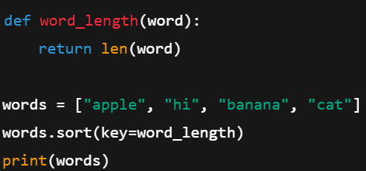
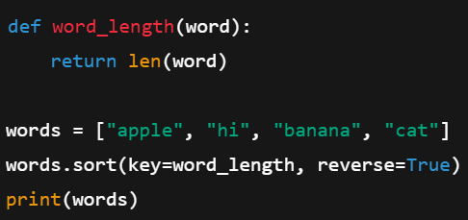
Custom Sort
Define a function to use as a sorting algorithm
The first example will sort the list from least>most words
We can have more than one key; The second example uses this to reverse the list

Slide 62
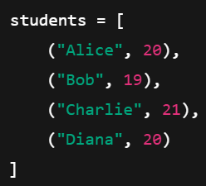


Lambdas
Instead of creating a custom sort function, we could also use a lambda!

Slide 63

Challenge
Goal:
Work with Lambdas
Details: ~10 min
Given the students list of tuples, do the following:
Sort the list so that it goes from oldest>youngest

Slide 64

Reversing a list

Slide 65
Other list methods
List Method Reference

Slide 66


Modules & Docstrings
my_module.py:
This can be another .py file or from a notebook:

Slide 67


Random Numbers

Slide 68
Challenge
Goal:
Complete PyCharm challenges
Details: ~20 min
Complete Day 4 (All Activities)
(Day 7 + 8 Recommended)

Slide 69
Tuples
Remember Tuples are:
Ordered, allows duplicates, & unchangeable
Can be any type & tuples can have mixed types
Access syntax is identical to lists
Tuples with one item require a trailing comma!
# One-item tuple (note the comma!)
b = (42,)

Slide 70

Tuples
We can’t change a tuple, but we can:
  Convert the tuple to a list
  Make a change, delete, or add items
  Convert the list back into a tuple

Slide 71

Unpacking Tuples

Slide 72


Count unique items & get the index of an item

Slide 73

Challenge
Goal:
Manipulate Tuples
Details: ~15 min
Given the following list of tuples, complete the following using only List Comprehension:
Print only students with an ‘A’
Print all names (but nothing else)
Give all the 20-year old students a ‘B’ and then print the list
Also the output

Slide 74
Sets
Sets are: unordered, unindexed, & items are unchangeable.
Any type and mixed types are allowed, but duplicated are not (1=True, 0=False considered duplicates):

Slide 75



Set Access
Either loop through it or use membership operators:

Slide 76





Add/Remove Set Items
We can’t modify set items but we can add/remove them:
**remove method has warnings, discard does not. **pop will remove random item

Slide 77
More on Sets
Join Sets
Frozen Sets
Set Method Reference

Slide 78

Challenge
Goal:
Manipulate Sets
Details: ~15 min
Given the following list, complete the following:
Create a set from the list to remove duplicates
Print the total number of attendees
Print ‘Alice is going!’ if Alice is found in the set
Add ‘Grace’ to the set
Remove ‘Bob’ from the set twice (don’t throw errors)
Print the final complete set of attendees

Slide 79

Dictionaries
Dictionaries are key/value pairs
Ordered, changeable, no duplicates
Python 3.6 and earlier - dictionaries are unordered
Access items with ‘[]’ syntax or thisdict.get(‘key’) method

Slide 80






Dictionaries

Slide 81





Dictionaries
Removes the last item, i.e. ‘year’:1964

Slide 82


Looping Dictionaries

Slide 83
Challenge
Goal:
Complete PyCharm challenges
Details: ~25 min
Complete Day 9 (All tasks)

Slide 84
What is Procedural Programming?
What is OOP?

Slide 85


Slide 86


Classes
The ‘self’ parameter must be included as the first parameter in any class method
Self has access to other class methods/variables
We can delete instantiations of a class
We can use the pass keyword as a placeholder

Slide 87

__init__ - totally not a constructor
Under the hood, a ‘__new__’ method gets called to create the object
‘__init__’ runs after, and initializes object state

Slide 88




Objects are very flexible in Python
Dot notation access: Change values: Delete values: Add new values:

Slide 89


__str__
The __str__ method controls what is returned when the object is printed

Slide 90



Inheritance
Inherit all the methods and properties from another class
Parent/Base Class
Child/Derived Class
This code is incomplete:

Slide 91




Inheritance
We need to add an __init__ in our child class so it doesn’t generally inherit the parent class __init__
We should use super() instead of calling the parent directly, so as not to break multiple-inheritance

Slide 92

Function Polymorphism
Polymorphism refers to functions/classes behaving differently depending on input or object type
Another example of function polymorphism is len()

Slide 93


Class Polymorphism

Slide 94




Encapsulation
Private method:
Single “_” denotes a protected property. This is only a convention.

Slide 95



Abstraction

Slide 96


Abstract Properties

Slide 97

Or just use a Protocol
Protocols are often the preferred way to abstract a class
No forced inheritance
Static type checking (mypy, pyright)
Flexible & easy setup

Slide 98

@staticmethod

Slide 99


@classmethod
Takes the class itself implicitly as ‘cls’
Belongs to the class, not the instance
Can access class variables and other class methods but NOT instance variables

Slide 100

SOLID app structure
Notebooks and unit tests should live separately from source code
Tests should mirror src layout
Each package should have its own ‘__init__.py’ file
pyproject.toml & poetry.lock will be autogenerated from our poetry commands

Slide 101
Manage Interpreters with pyenv-win
https://github.com/pyenv-win/pyenv-win
Install:
Invoke-WebRequest -UseBasicParsing -Uri "https://raw.githubusercontent.com/pyenv-win/pyenv-win/master/pyenv-win/install-pyenv-win.ps1" -OutFile "./install-pyenv-win.ps1"; &"./install-pyenv-win.ps1
Run pyenv --version to check if the installation was successful.
Run pyenv install -l to check a list of Python versions supported by pyenv-win
Run pyenv install <version> to install the supported version
Run pyenv global <version> to set a Python version as the global version

Slide 102
Poetry
Use the official installer (curl)
Set virtual environments to install in project folder
Install deps and dev deps
install/lock
Run your app

Slide 103
Pause Here
(We build a REPL app with SOLID principles)
Code-along suggested; too much for slides

